Slide 1
Introduction to R
Rajasekhar Jetty

Slide 2
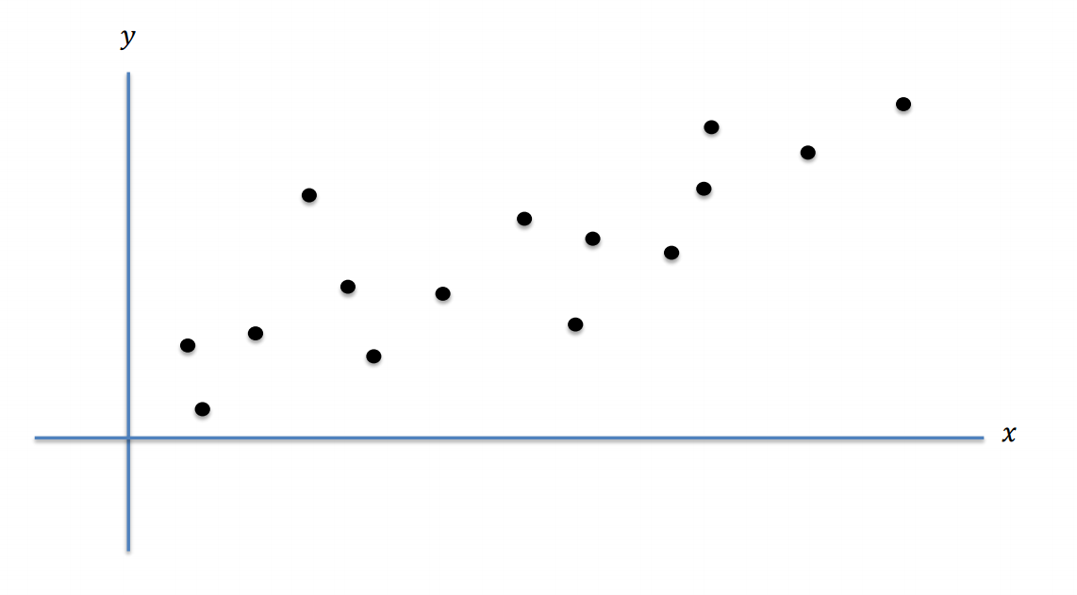
Fitting Linear Model

Slide 3
lm (used to fit linear models)
Usage :
Package : stats
lm(formula, data, subset, weights, na.action,method = "qr", model = TRUE, x = FALSE, y = FALSE, qr = TRUE, singular.ok = TRUE, contrasts = NULL, offset, ...)
Eg:
ctl <- c(4.17,5.58,5.18,6.11,4.50,4.61,5.17,4.53,5.33,5.14)
trt <- c(4.81,4.17,4.41,3.59,5.87,3.83,6.03,4.89,4.32,4.69)
group <- gl(2, 10, 20, labels = c("Ctl","Trt"))
weight <- c(ctl, trt)
lm.D9 <- lm(weight ~ group)

Slide 4
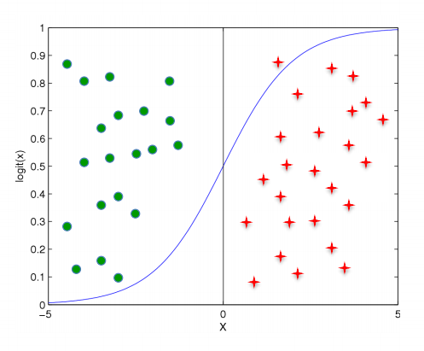
Logistic Regression

Slide 5
glm(Generalized Linear Model)
Usage
glm(formula, family = gaussian, data, weights, subset, na.action, start = NULL, etastart, mustart, offset, control = list(...), model = TRUE, method = "glm.fit", x = FALSE, y = TRUE, contrasts = NULL, ...)

Slide 6
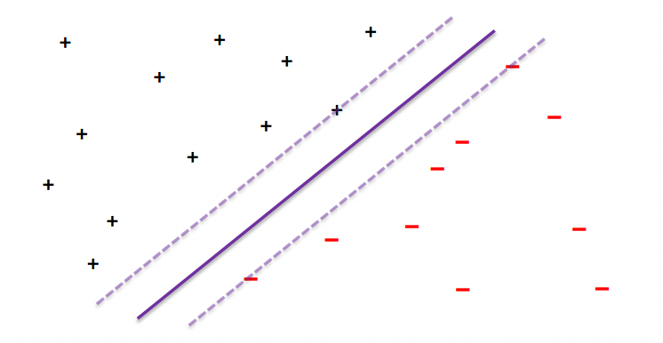
Support Vector Machines

Slide 7
svm()
package : e1071 as svm()
Usage:
svm((x, y = NULL, scale = TRUE, type = NULL, kernel ="radial", degree = 3, gamma = if (is.vector(x)) 1 else 1 / ncol(x),coef0 = 0, cost = 1, nu = 0.5,class.weights = NULL, cachesize = 40, tolerance = 0.001, epsilon = 0.1,shrinking = TRUE, cross = 0, probability = FALSE, fitted = TRUE,..., subset, na.action = na.omit))

Slide 8
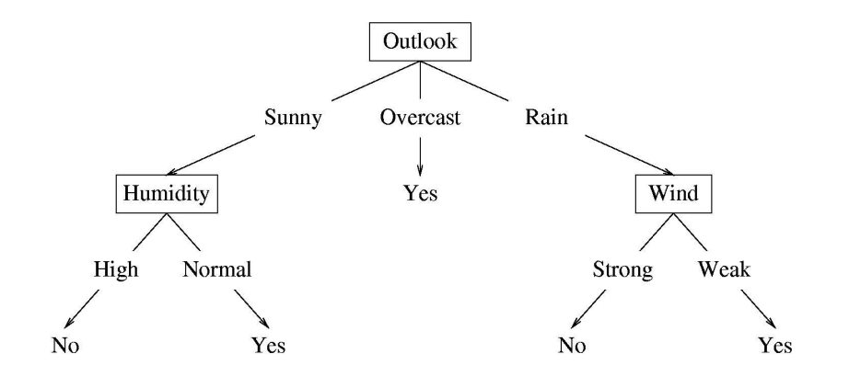
Trees

Slide 9
rpart
Usage :
Package : rpart
rpart(formula, data, weights, subset, na.action = na.rpart, method, model = FALSE, x = FALSE, y = TRUE, parms, control, cost, ...)

Slide 10
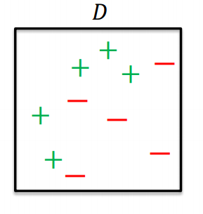
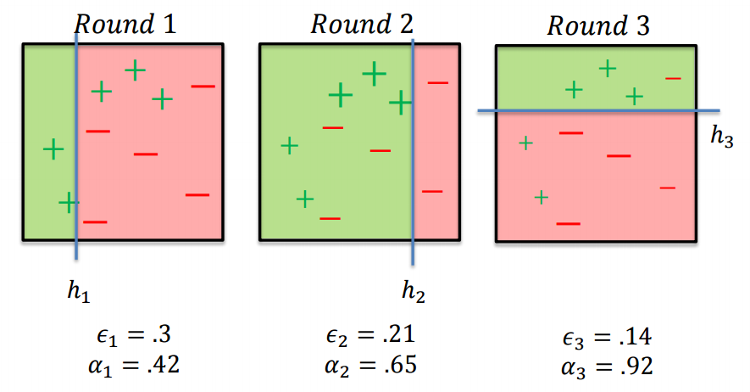
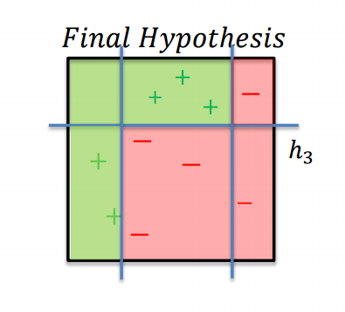
AdaBoost

Slide 11
AdaBoost & Gradient Boosted Machine
AdaBoost
Package : ada
ada(x, y,test.x,test.y=NULL, loss=c("exponential","logistic“`),
type=c("discrete","real","gentle"),iter=50, nu=0.1, bag.frac=0.5,
model.coef=TRUE,bag.shift=FALSE,max.iter=20,delta=10^(-10),verbose=FALSE,
...,na.action=na.rpart)
Gradient Boost
library(gbm)
gbm(formula = formula(data), distribution = "bernoulli", data = list(), weights, var.monotone = NULL, n.trees = 100, interaction.depth = 1, n.minobsinnode = 10, shrinkage = 0.001, bag.fraction = 0.5, train.fraction = 1.0, cv.folds=0, keep.data = TRUE, verbose = "CV", class.stratify.cv=NULL, n.cores = NULL)

Slide 12
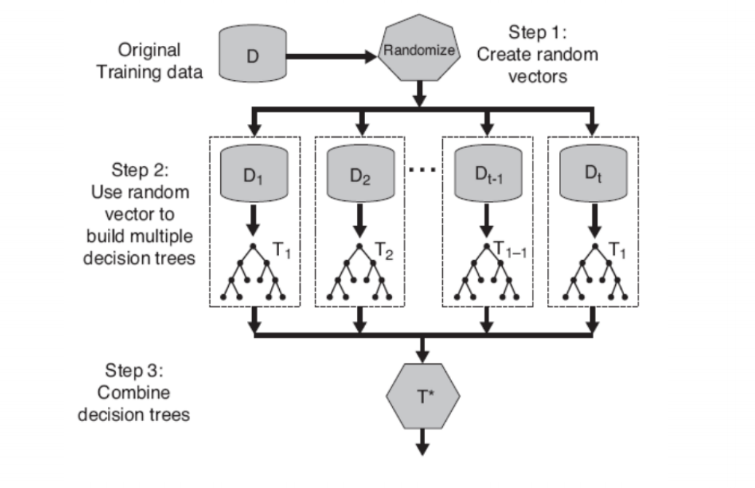
Random Forest

Slide 13
Random Forest
Package : ‘randomForest’
randomForest((x, y=NULL, xtest=NULL, ytest=NULL, ntree=500,
mtry=if (!is.null(y) && !is.factor(y))
max(floor(ncol(x)/3), 1) else floor(sqrt(ncol(x))),
replace=TRUE, classwt=NULL, cutoff, strata,
sampsize = if (replace) nrow(x) else ceiling(.632*nrow(x)),
nodesize = if (!is.null(y) && !is.factor(y)) 5 else 1,
maxnodes = NULL,
importance=FALSE, localImp=FALSE, nPerm=1,
proximity, oob.prox=proximity,
norm.votes=TRUE, do.trace=FALSE,
keep.forest=!is.null(y) && is.null(xtest), corr.bias=FALSE,
keep.inbag=FALSE, ...))

Slide 14
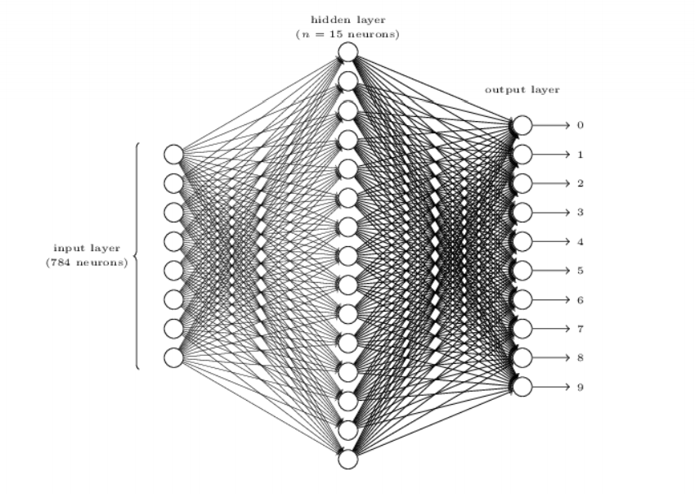
Neural Network

Slide 15
Neural Network
Usage:
Package : neuralnet
neuralnet(formula, data, hidden = 1, threshold = 0.01,
stepmax = 1e+05, rep = 1, startweights = NULL,
learningrate.limit = NULL,
learningrate.factor = list(minus = 0.5, plus = 1.2),
learningrate=NULL, lifesign = "none",
lifesign.step = 1000, algorithm = "rprop+",
err.fct = "sse", act.fct = "logistic",
linear.output = TRUE, exclude = NULL,
constant.weights = NULL, likelihood = FALSE)

Slide 16
H2O Deep Learning
H2O Package
Package : h2o
h2o.init() iris.hex <- as.h2o(iris) iris.dl <- h2o.deeplearning(x = 1:4, y = 5, training_frame = iris.hex)

Slide 17
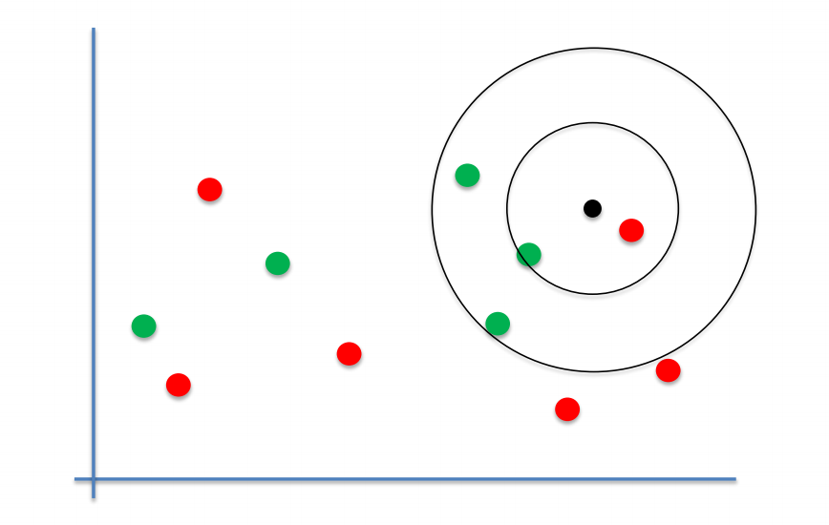
K Nearest Neighbour

Slide 18
k-Nearest Neighbour Regression
Package: Caret
knnreg((formula, data, subset, na.action, k = 5, ...))

Slide 19
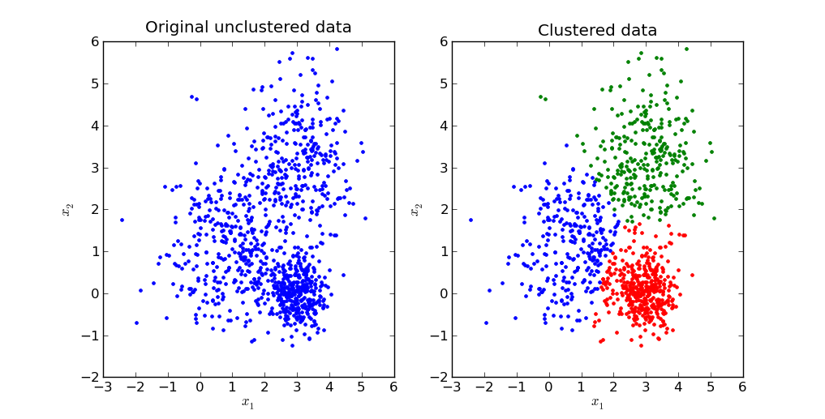
K Means

Slide 20
K-Means Clustering
Package: stats
kmeans(x, centers, iter.max = 10, nstart = 1,
algorithm = c("Hartigan-Wong", "Lloyd", "Forgy",
"MacQueen"), trace=FALSE)
## S3 method for class 'kmeans'
fitted(object, method = c("centers", "classes"), ...)

Slide 21
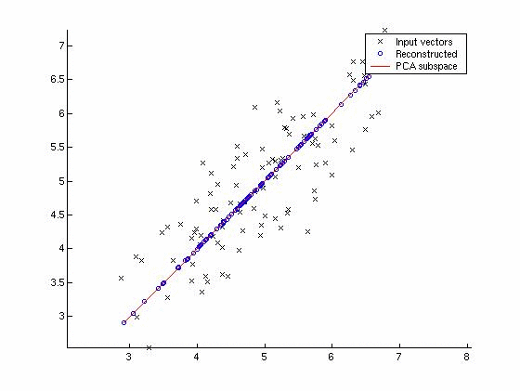
Principal Components Analysis (PCA)

Slide 22
PCA
Package : stats
princomp(x, cor = FALSE, scores = TRUE, covmat = NULL,
subset = rep_len(TRUE, nrow(as.matrix(x))), ...)

Slide 23
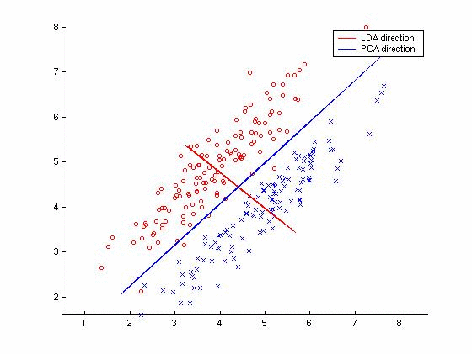
Linear Discriminant Analysis (LDA)

Slide 24
Linear Discriminant Analysis (LDA)
Package: MASS
lda(x, grouping, prior = proportions, tol = 1.0e-4,
method, CV = FALSE, nu, ...)

Slide 25
T-distributed Stochastic Neighbor Embedding (t-SNE)
Package: tsne
tsne(X, initial_config = NULL, k = 2, initial_dims = 30, perplexity = 30, max_iter = 1000, min_cost = 0, epoch_callback = NULL, whiten = TRUE, epoch=100)

